Slide 1

Instructions for using Zoom
Congress Travel

Slide 2
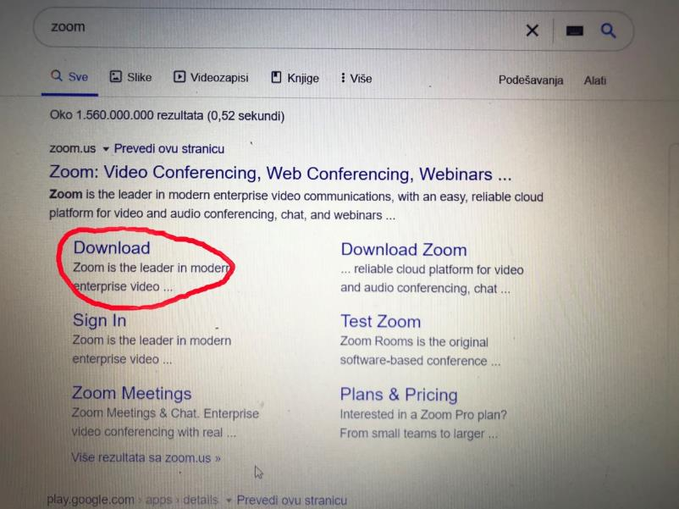
Downolad and Save Zoom Application on your computer

Slide 3
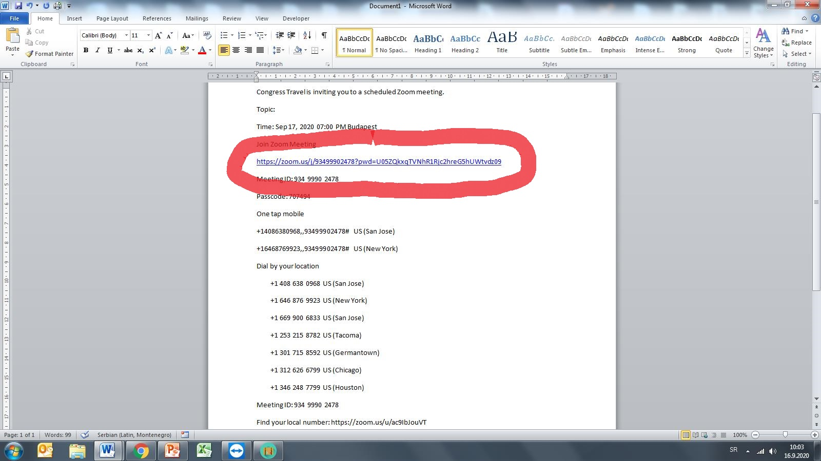
Click on the Zoom link sent by and organizer

Slide 4
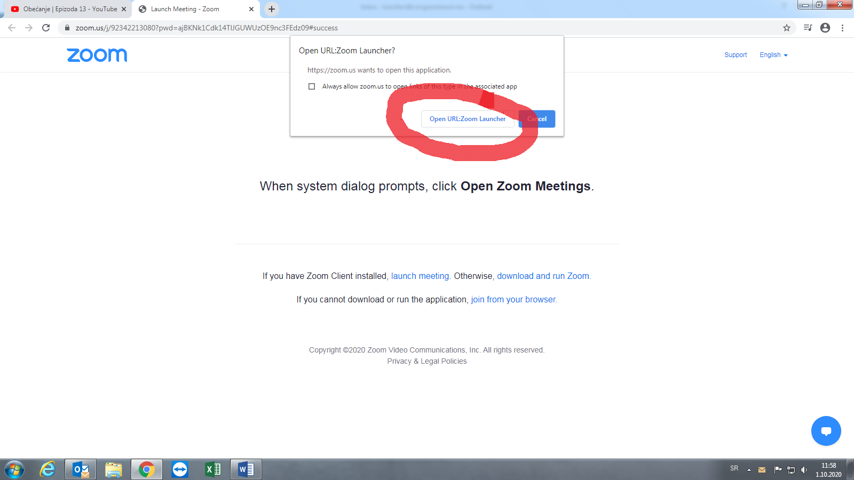
When you click on a link for an online meeting confirm the option url-zoom launcher

Slide 5
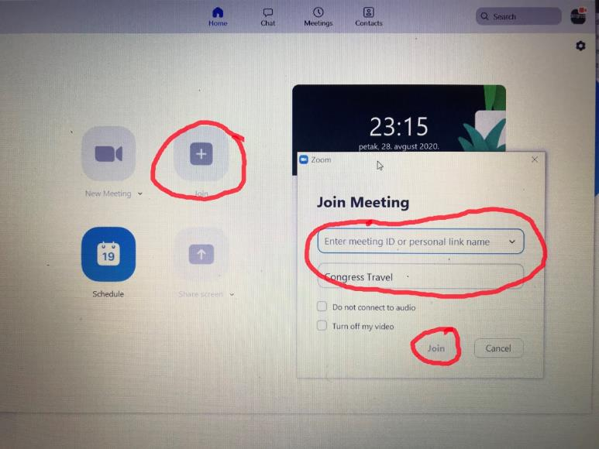
Enter your information in the window that appears on the screen.
You should always use your full name and surname in order to join a meeting without difficulties.

Slide 6
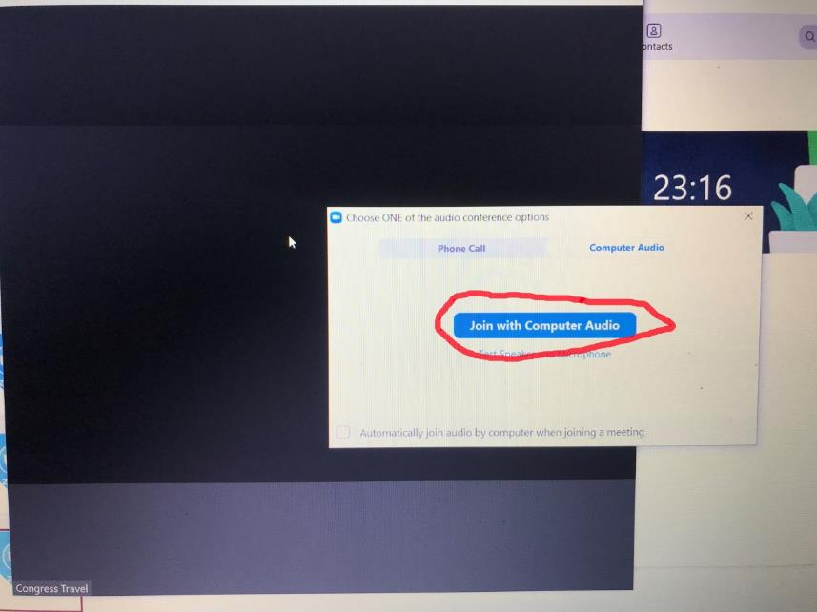
Select option
Join with computer audio

Slide 7
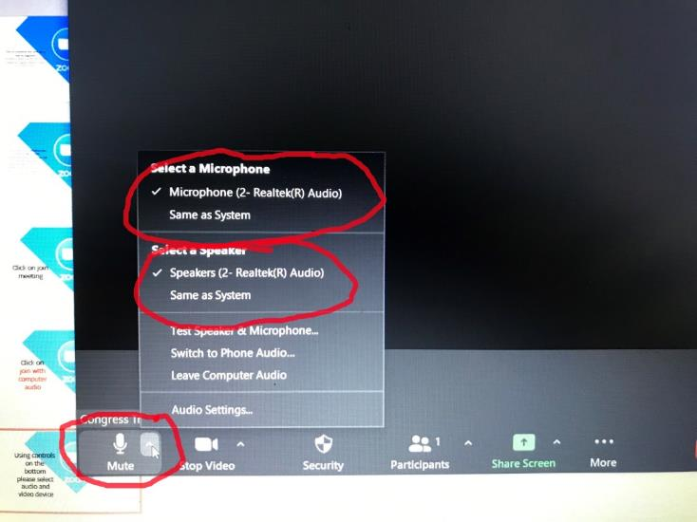
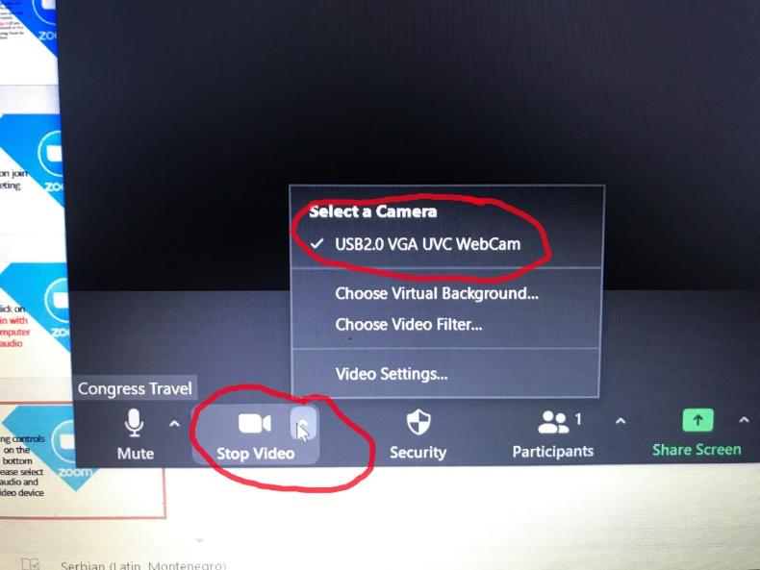
You can choose audio and video device by using controls at the bottom of the screen

Slide 8
The most effective way to follow an online event is to use headphones with a microphone!

Slide 9
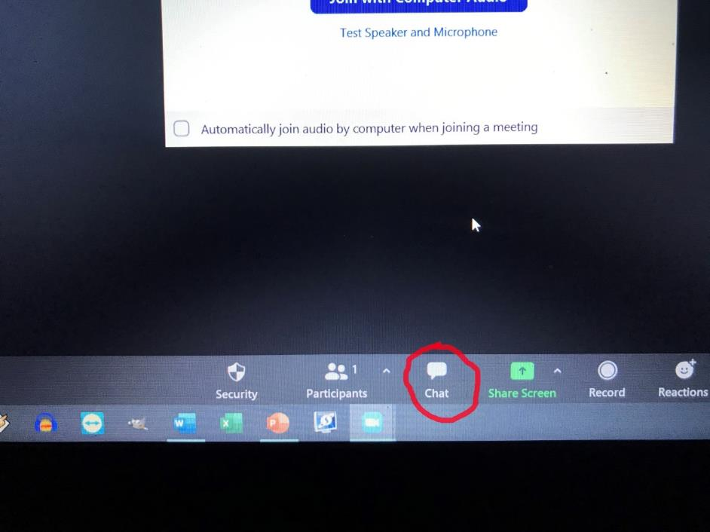
You can use Chat Option if you have some questions for administrator or lecturer

Slide 10
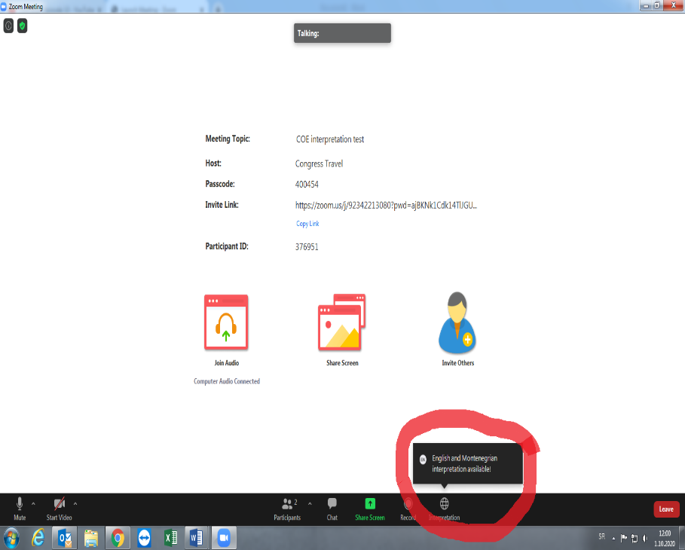
INTERPRETATION icon will appear on the screen only in cases where the interpretation is provided for a meeting

Slide 11
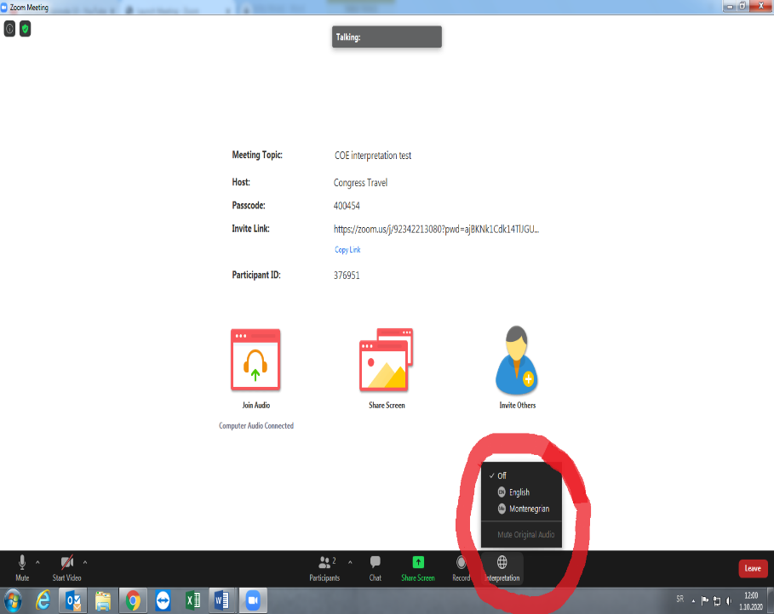
Select the language you want.

Slide 12
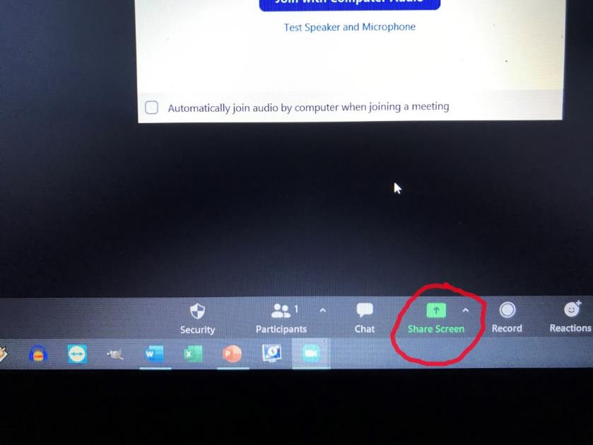
If you are a lecturer or you have presentation or document that you want to share with other participants, choose the option Share Screen

Slide 13
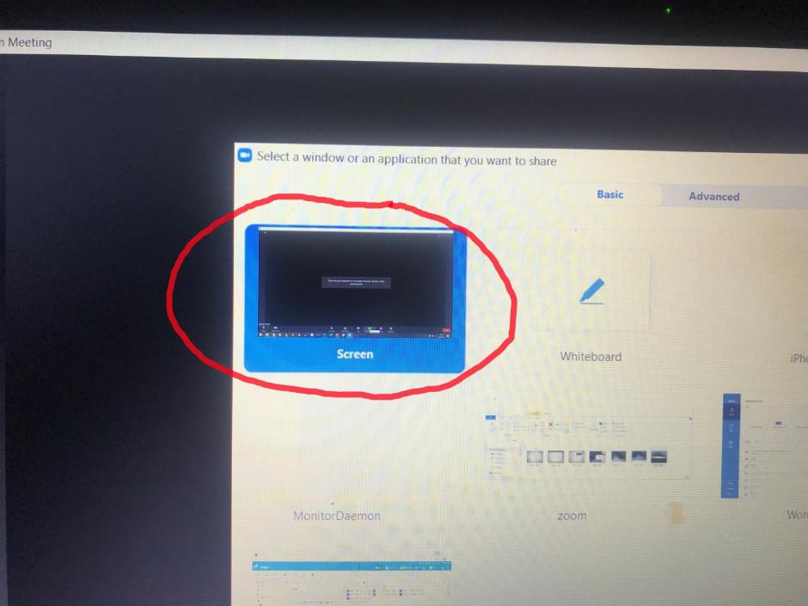
Open your presentation and choose the option Scren

Slide 14
Contact Host
(administrator) via chat or e-mail
(equipment@congresstravel.me) or by phone :+38267249854 for additional help

Slide 15
Enjoy your Webinar!

